Slide 1
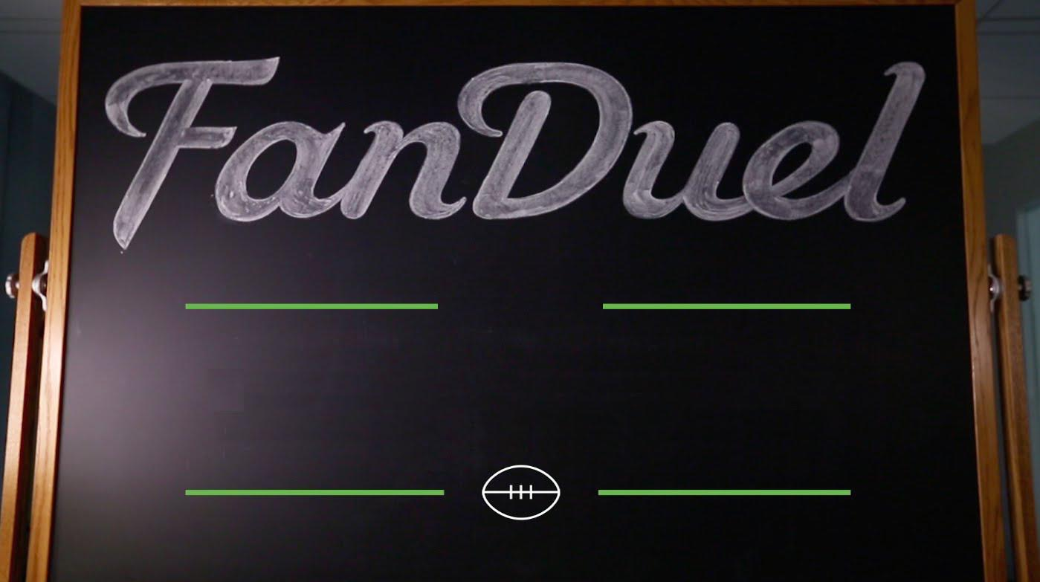
Fantasy Forecast
Weekly
By: Timothy Lagrimas

Slide 2
Problem?
Fantasy Forecast

Slide 3
Solution!
Fantasy Forecast

Slide 4
Overview
Fantasy Forecast
Entries up to $5,300
Winnings up to $25,000
Top 3 win cash prizes.
Statistical Prediction Software
FanDuel Lineup Optimizer
One-Week 10-Player Leagues

Slide 5
Assumptions
Fantasy Forecast
Operating System | Browsers
Windows 2000 or later | Chrome & Firefox
Mac OS X 10.6.4 or later (Snow Leopard) | Chrome & Firefox

Slide 6
How does it do?
Fantasy Forecast

Slide 7
Regression Analysis
Fantasy Forecast

Slide 8
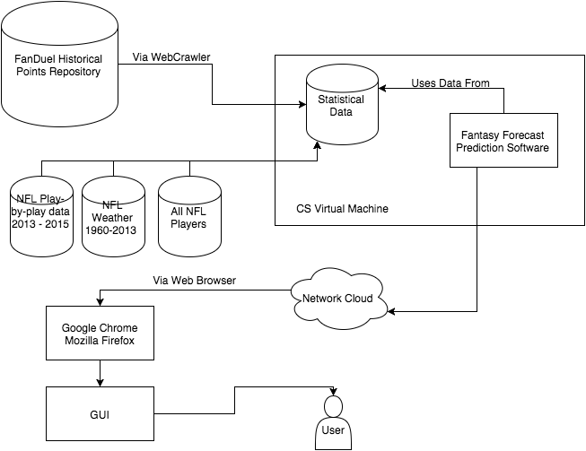
System Diagram
Fantasy Forecast

Slide 9
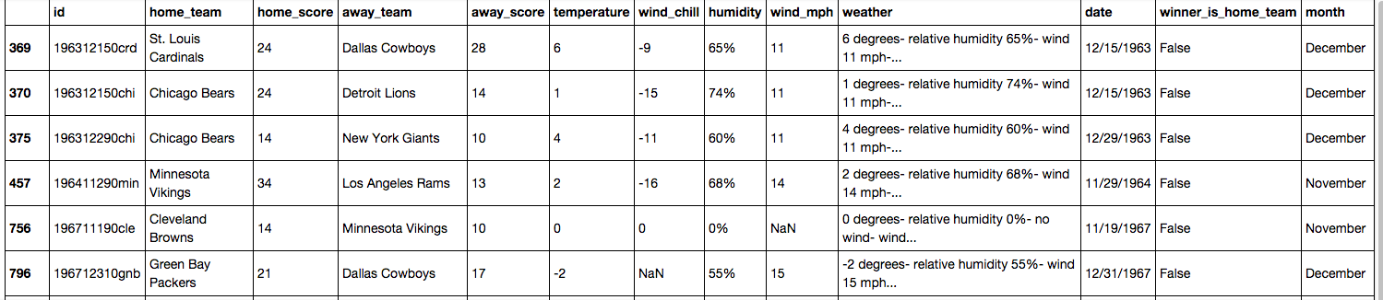
Weather
Fantasy Forecast

Slide 10
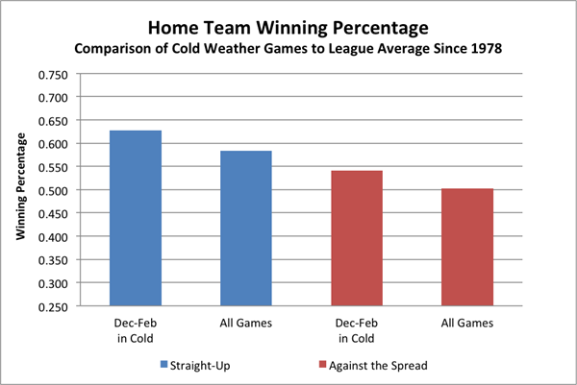
Weather
Fantasy Forecast

Slide 11
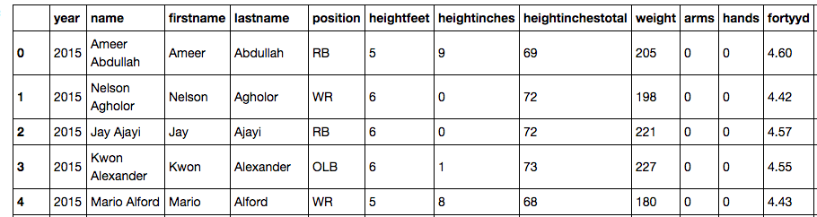
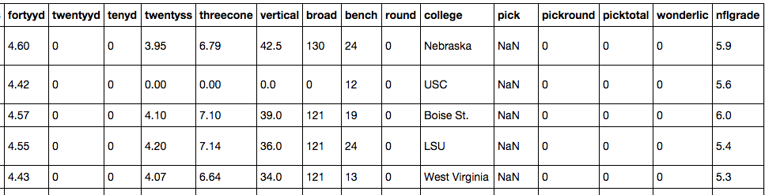
All NFL Players
Fantasy Forecast

Slide 12
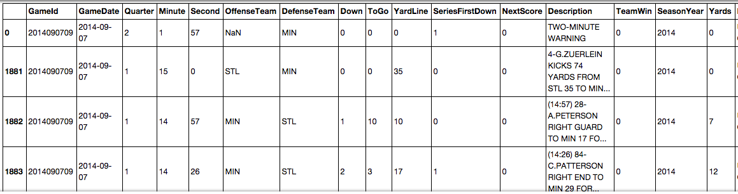
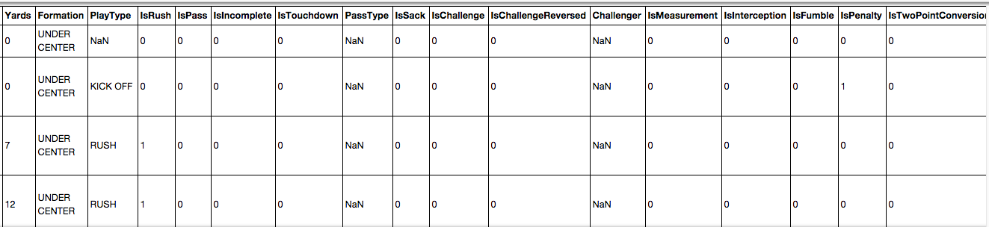
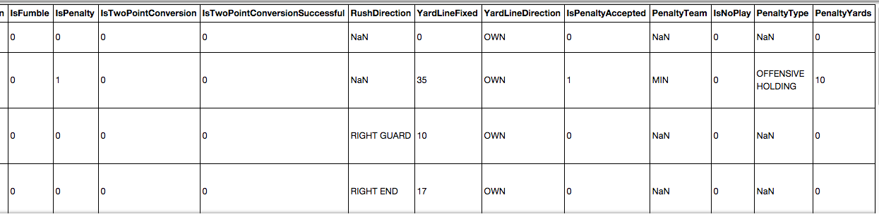
Play-By-Play
Fantasy Forecast

Slide 13
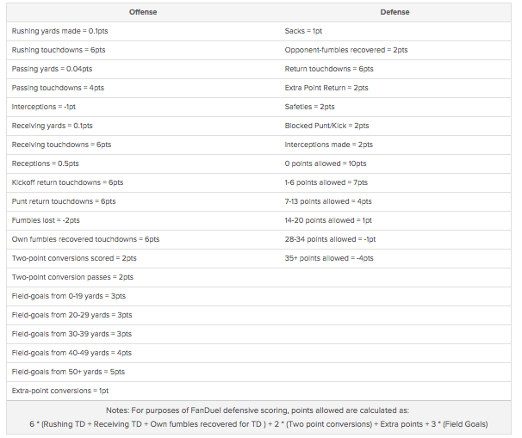
FD Point System
Fantasy Forecast

Slide 14
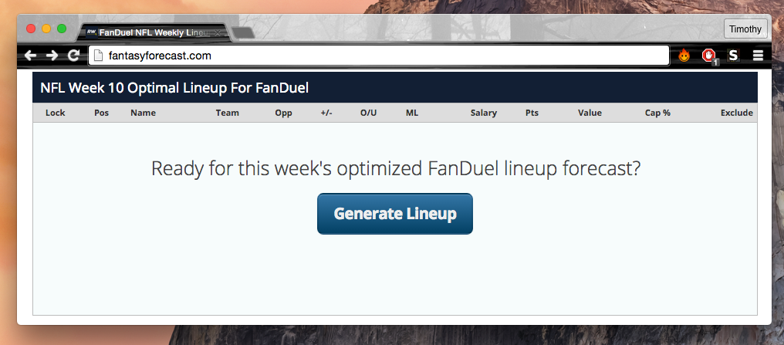
Main User Story
Fantasy Forecast
User goes to the Fantasy Forecast website.

Slide 15
Main User Story
Main User Story
Fantasy Forecast
Fantasy Forecast
User presses the “generate lineup” button

Slide 16
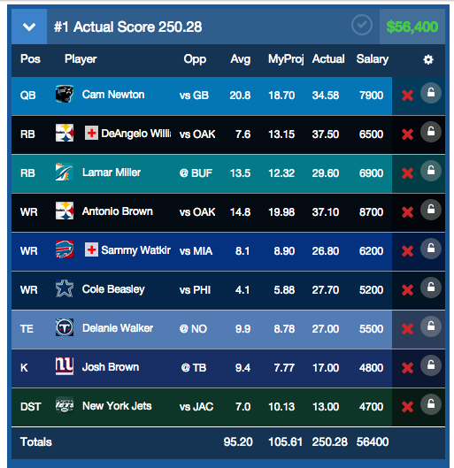
Main User Story
Fantasy Forecast
User is presented with a lineup

Slide 17
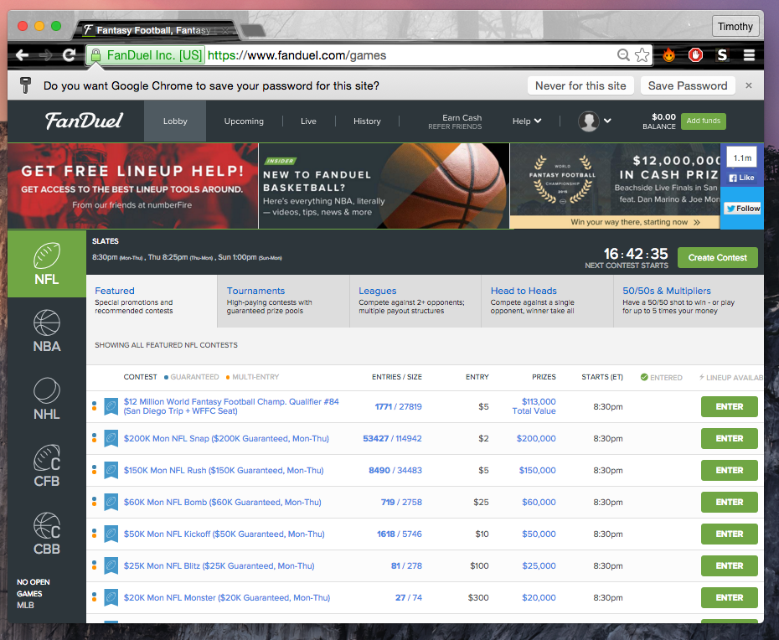
Main User Story
Fantasy Forecast
User goes to the NFL league table

Slide 18
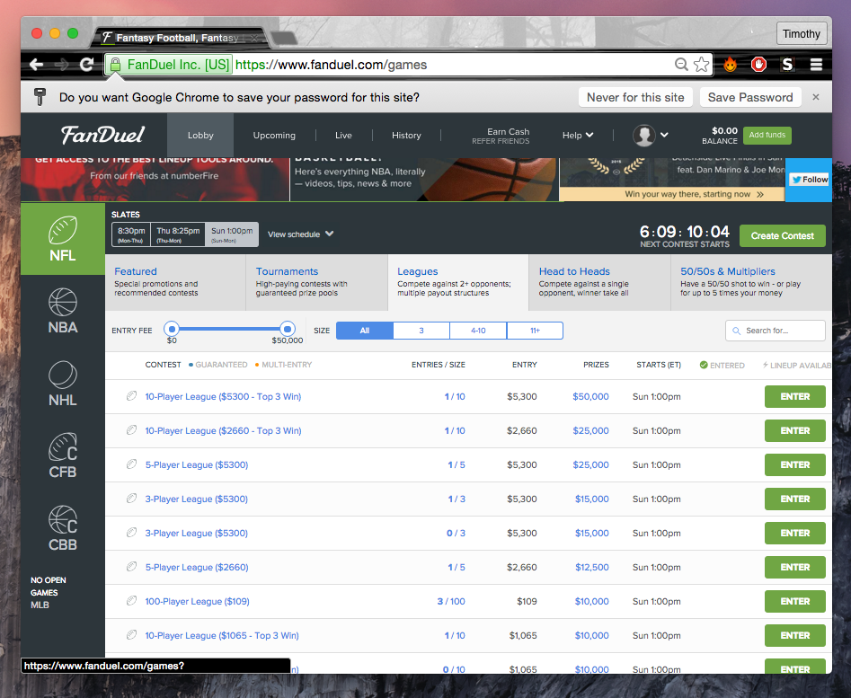
Main User Story
Fantasy Forecast
User enters a contest

Slide 19
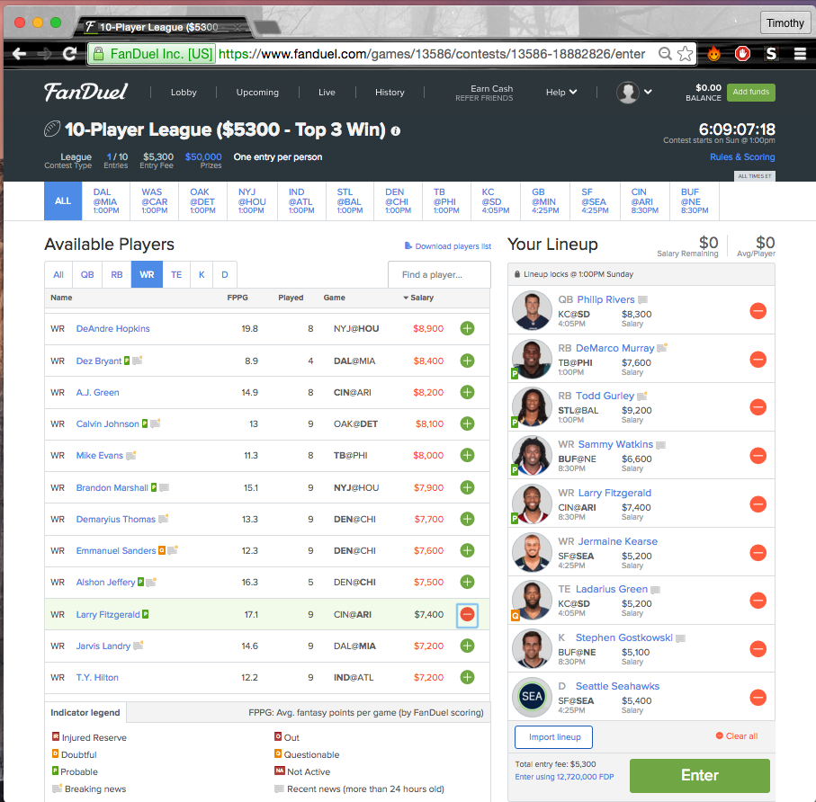
Main User Story
Fantasy Forecast
User inputs the generated lineup for the respected week into FanDuel

Slide 20
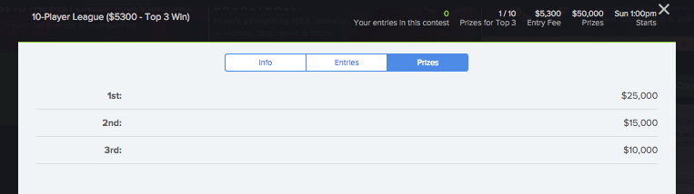
Main User Story
Fantasy Forecast
If the user finishes in the top 3, they win real money instantly!

Slide 21
Ponder
Fantasy Forecast
Why did ____ flame out?
Why is ____ so inconsistent across the board?
____ was projected to do amazing this year, what happened?
Inaccurate player evaluations

Slide 22
Completed and Future Work
Fantasy Forecast
Task | Description | Status
Find FD Repo | All historic FD data will be needed for testing | Done
Web Crawler | If no downloadable stats, grab data through crawler | Done
Pandas | Use for data analysis workflow | Done
iPython Notebook | Use for data analysis workflow | Done
MatPlotLib | Use for data analysis workflow | Done
NumPy | Use for data analysis workflow | Done
Seaborn | Use for data analysis workflow | Done
Linear Regression Model | Create a plot with linear regression model | Done
Predict Single Player FD points | In one position, predict a players points for upcoming week | Done
Multi-Level Regression Model | Multi-Level Regression models are more accurate than linear regression models | Not Done

Slide 23
Completed and Future Work
Fantasy Forecast
Task | Description | Status
Data Frame automation | For entire season | Done
Data Frame automation | For weeks | Done
Data Frame automation | Per player | Done
Regression Analysis on Weather |  | In Process
Regression Analysis on Play-By-Play |  | In Process
Strength of Schedule | Create Strength of Schedule Maker | Not Done
Player vs Strength of Defense | How do they matchup? | Not Done
Strength of Defense vs Similar Players Already Played |  | Not Done
Player vs Player Against Common Opponents | Who is the stronger producer against common opponents | Not Done
Predict Single Player FD points automation | In one position, automatically predict multiple players points for upcoming week | Not Done
Predict all positions | In all positions, automatically predict multiple players points for upcoming week | Not Done
Generate best lineup | generate the best predicted 9 player lineup to produce most points | Not Done
$60,000 Salary Constraint | Constrain the 9 man lineup to a $60,000 Salary cap | Not Done

Slide 24
Fantasy Forecast
Stay safe out there! Keep up with your weekly Fantasy Forecast!

